Slide 1
Simpsons Character Recognition Presentation
By 林文淵 博一
學號: 110369007

Slide 2
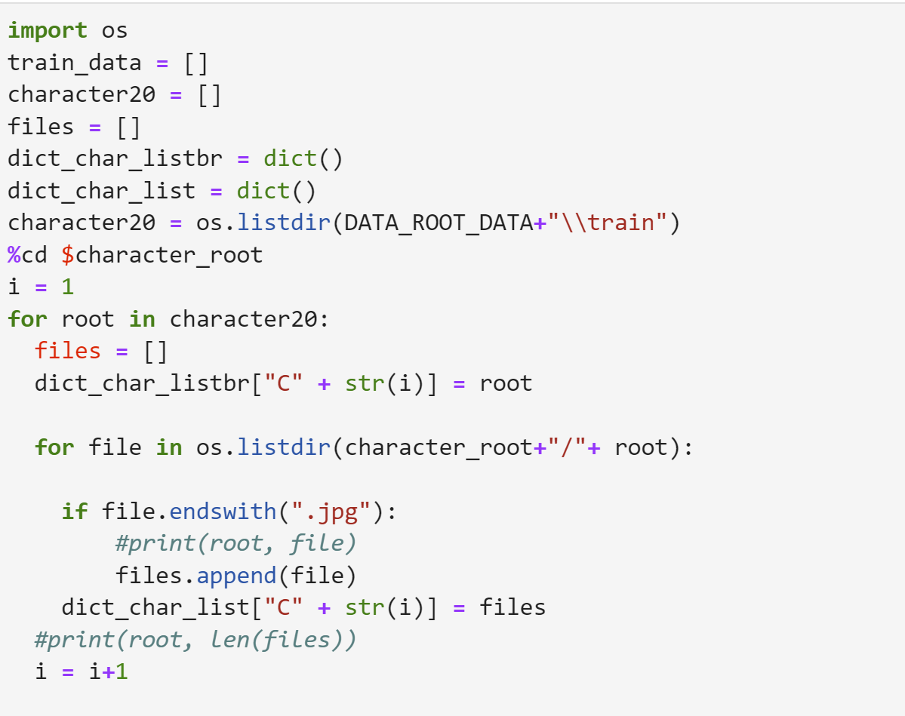
Read data and assign to dictionary

Slide 3
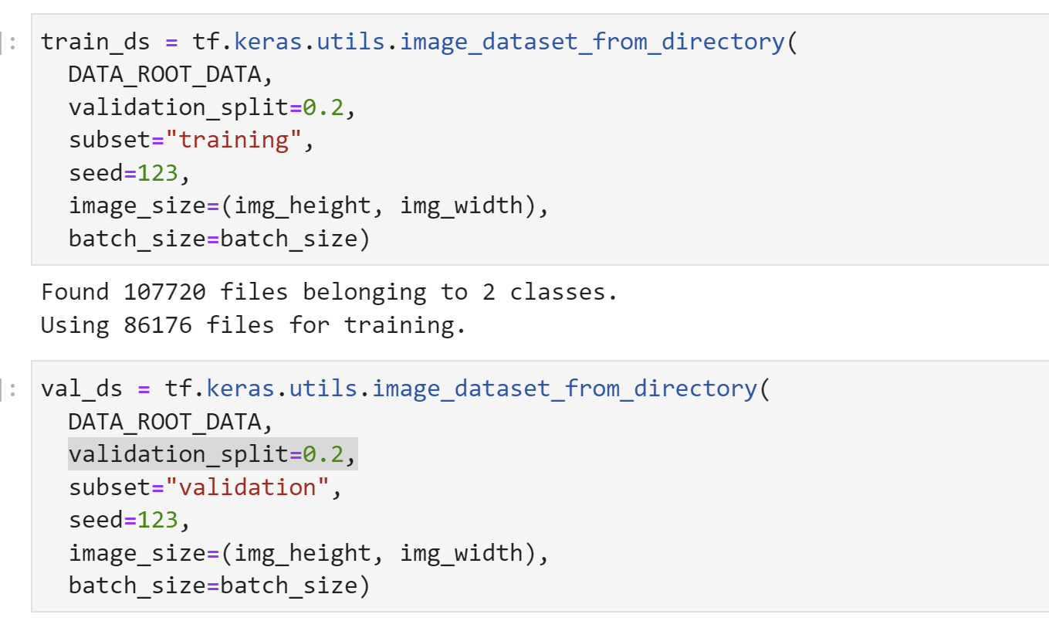
Create a dataset with 2 classes

Slide 4
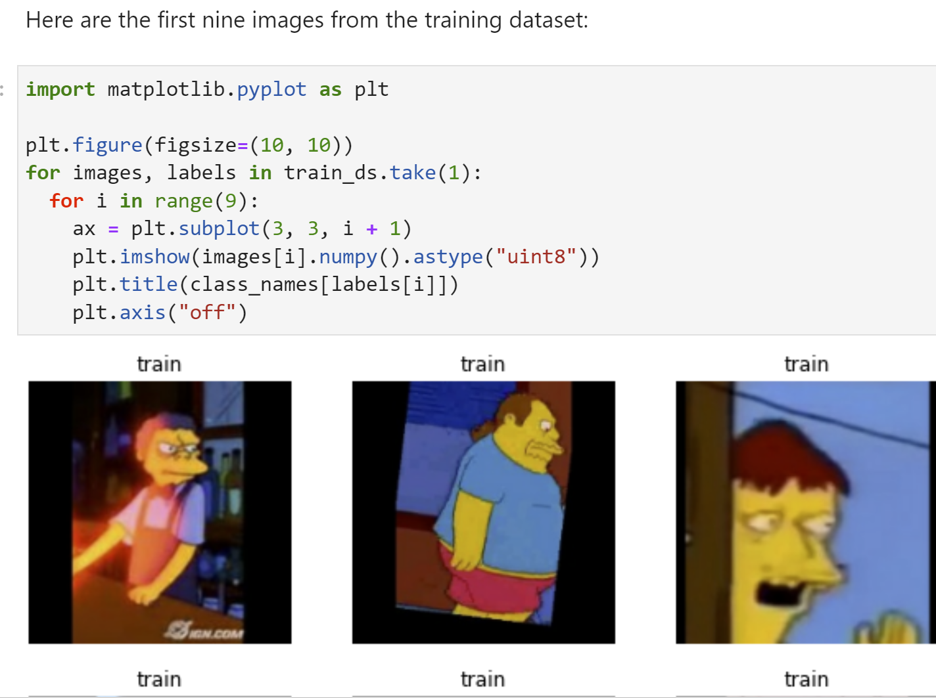
Visualize the data

Slide 5
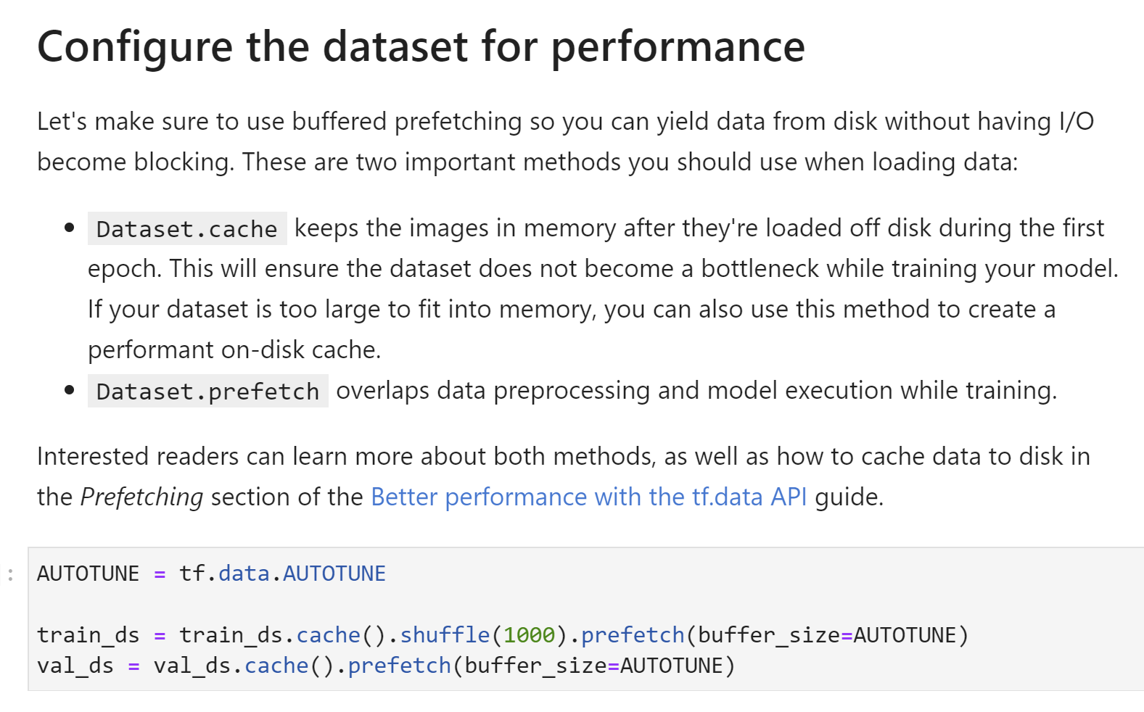

Slide 6
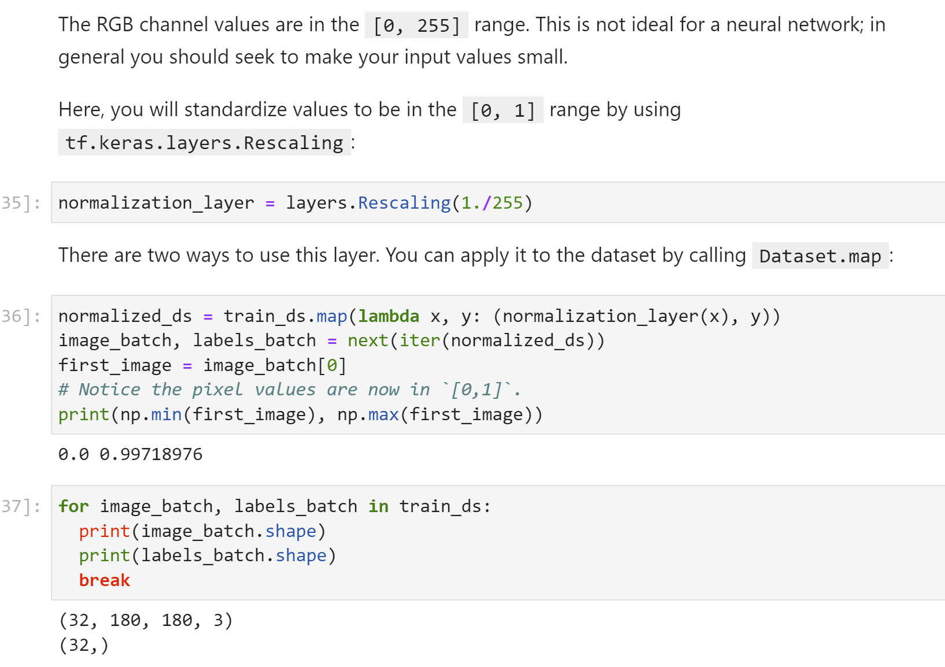
Standardize the data

Slide 7
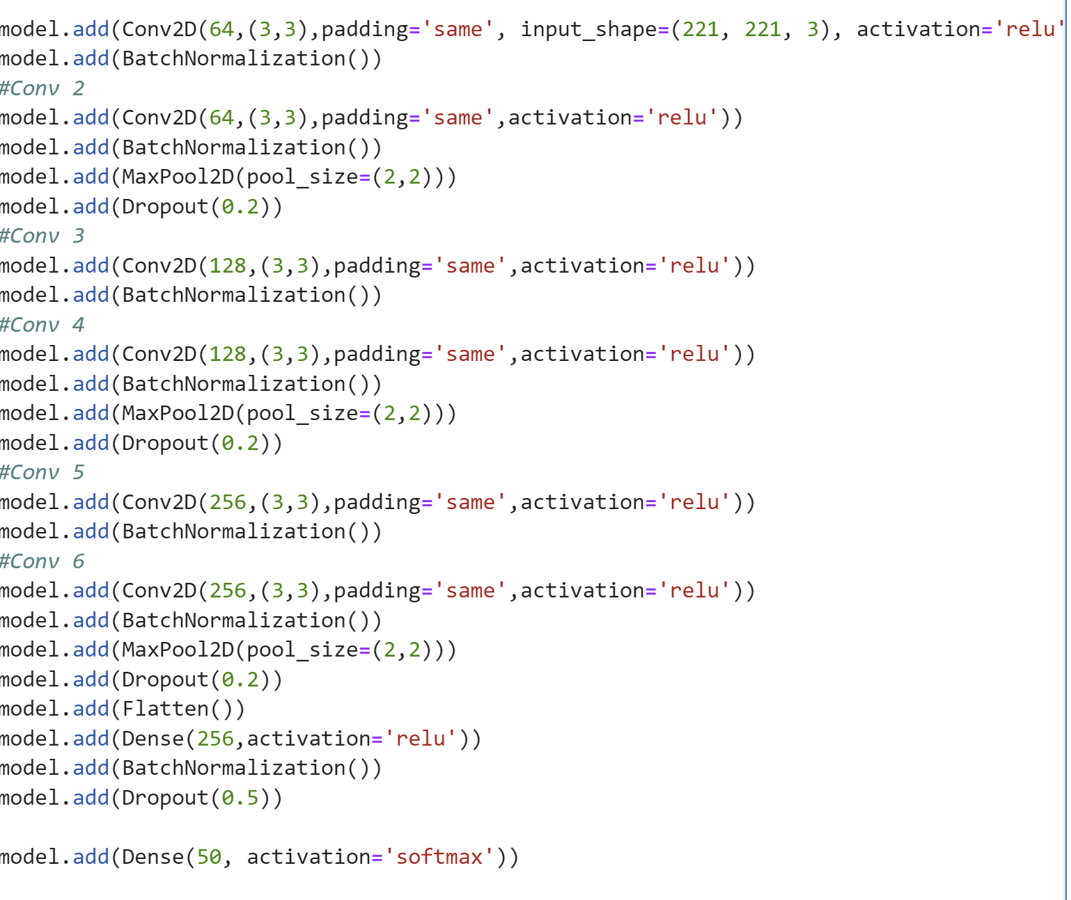
Create the model

Slide 8
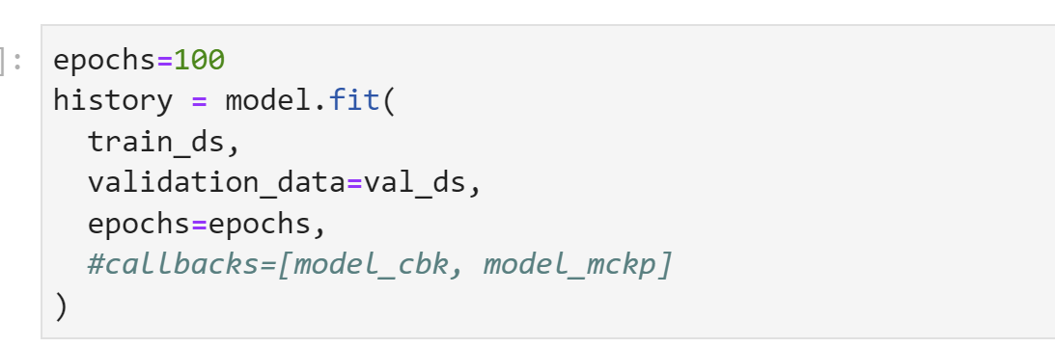
Train the model

Slide 9
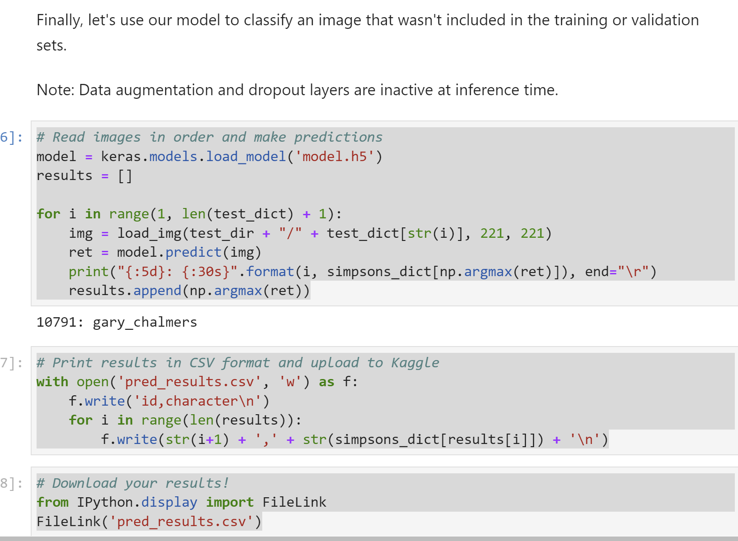
Predict on test data

